Slide 1




Business Intelligence Vendor Analysis Proven Professionals
Connor LaMalfa
Deepti Deshpande
Art Miller
Ben Martin

Slide 2

MasterControl Business Analytics Project
Scope: Design and implement a business analytics platform and visualization tool, which will help leverage existing data generated, warehoused, and stored from various sources in the MasterControl hosted and external environments
Source Systems
Data Warehouse (ETL Process)
End User Data Analysis Tools
Cloud Hosted data
Currently Master Control is running Domo as a BI solution, although inexperienced end users (PM’s) seem to gravitate away from using it for the following reasons:
-Lack of support resources (i.e. training, help documents)
-Usability for inexperienced users
-Lack of process /workflow for requesting reports if a user doesn’t have a license, (possibly due to cost)
-Ability to pull/process various data sources
Extract
Utilizes Microsoft SQL Server Enterprise to build and manage warehouse and integrate them with other Microsoft BI products
SQL Server Integration Services– Fast and flexible DW tool used for ETL and data migration tasks
Feed
SalesForce
Extract
NetSuite
Extract
Feed
On-site data
Extract
Feed
Flat files
Extract

Slide 3
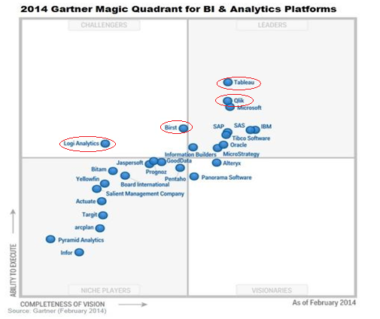
Proven Professional’s Project Goal
Identify, Test, Evaluate, and Score 4 potential BI software vendors and present results to MasterControl as possible alternatives to Domo
Process Steps:
Analyzed Business Analytics and BI vendor industry
Gartner BI Magic Quadrant
2. Chose the following vendors:
Logi Analytics
Birst
Qliktech
Tableau

Slide 4
Process Steps:
3. Created BI Vendor Scoring Matrix for comparison and ranking purposes
Critical Categories and Subjects were created
Subject weights were then divvied based on what our group felt MC was most looking for in a product
Category | Subject | Notes | Weight (out of 100) | Rating (1-10)
Capability – The feature set offered by each tool | Design (look and feel) |  | 5
 | Performance |  | 15
 | Metadata |  | 10
 | Ease of use (usability) |  | 20
Integration – Integration within the company environment, existing data warehouse tools and established infrastructure and policies | Company-specific capabilities |  | 5
 | Configuration/Data Sources |  | 15
 | Scheduling/Monitoring |  | 5
 | Support Resources |  | 5
Vendor – product vision/use, marketshare, industry experience/track record, corporate stability, reviews, price | Vendor overview |  | 10
 | Pricing |  | 10

Slide 5
Process Steps:
4. Created Use Cases to help evaluate subjects in order to test functionality of product
3 use cases were created
Used a uniform dataset for testing purposes (Bank dataset from Lab_4)
5. Conducted evaluation of the BI Tools
Each group member was assigned 2 vendors
Art – Logi Analytics, Tableau
Connor – Birst, Qlik
Deepti – Tableau, Birst
Ben – Qlik, Logi Analytics
Results, impressions, performance, design, usability, etc. were all captured cataloged and documented within the “BI Vendor Scoring Matrix” notes section
6. Members then gave rankings to each Subject Category
Ratings were averaged between the two group member matrices for a given vendor product
7. Summary and Recommendation reports created for each BI tool
Put summary/recommendation in terms of:
“Does this product meet MasterControl’s criteria for adoption, integration and phase out of Domo?”
“Why would/wouldn’t you recommend this product to MasterControl?

Slide 6

Positives
Negatives
Sleek, clean, modern design with large buttons and tabs
Visuals are extremely intuitive and easy to adjust (drag and drop functionality)
Ability to scale performance levels when adding users, data and apps
Integrates well with MC data warehouse
Supported data connections/sources:
Data folders/files
ODBC – MySQL,Oracle, SAP, MS SQL
Salesforce CRM
Big data sources such as Hadoop Hive, Impala, Amazon EC2, etc
Premium support, training, consultation services, and CBTs
Almost too easy to use, lacks options that other tools have
Comparatively expensive
A ‘concurrent license’ that allows one user at a time for $15,000. Clients can share more than 11 users on a single license
Lowest entry for a fully functional version is $,1350. ‘Named User License’ can read Qlikview files created on other machines

Slide 7
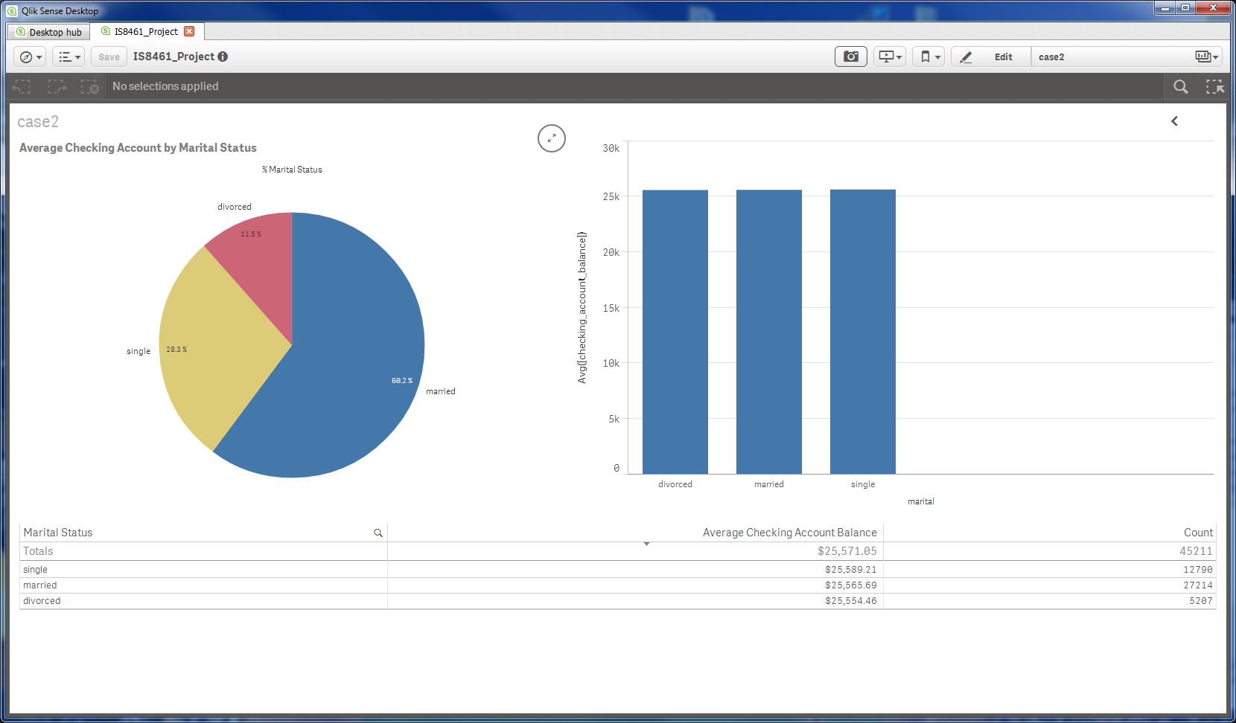
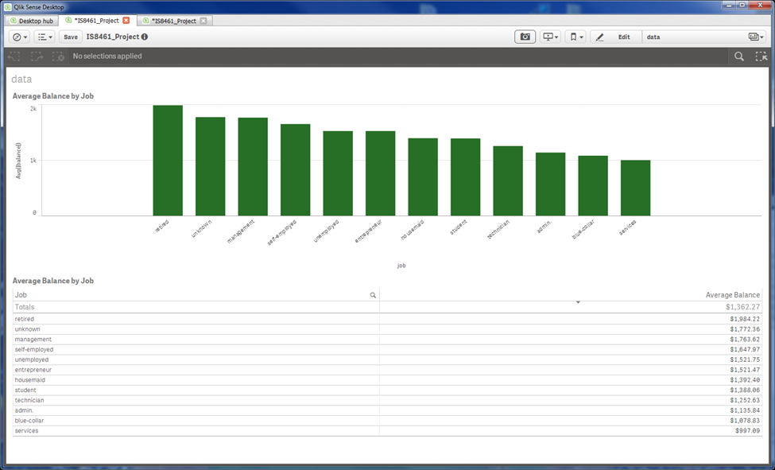
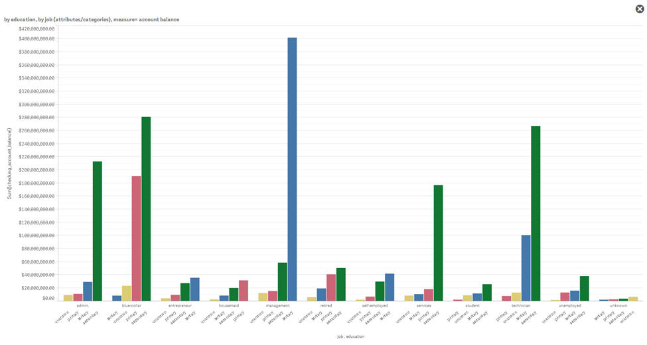
Qlik Visuals

Slide 8
Positives
Negatives
Easy to navigate work flow progression built into the design of the app
Cloud analytics is where Birst holds its edge over most BI products, combining its agility and ease of use with the speed and scalability of cloud
Pre built application connections for data source pulls from Netsuite (JDBC), Salesforce, Google analytics, Omiture SiteCatalyst
Can schedule to have a pre-created report sent from Birst automatically based on a recurring schedule at a specific time and interval
Visualization editing properties were confusing to use to make changes
Seems need expert level BI or IT analysts who know how to manipulate the data with ease
Less visual tools than other BI software
Extremely disappointed in the BI tool’s inability handle some of the data values appropriately
Unable to classify ‘checking_account_balance’ as a measure
Support resources were not as available as they were with other tools (useless help page)

Slide 9
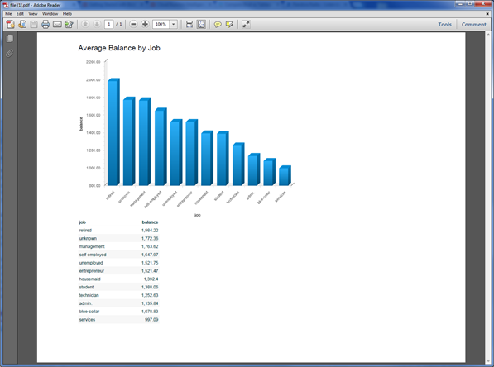
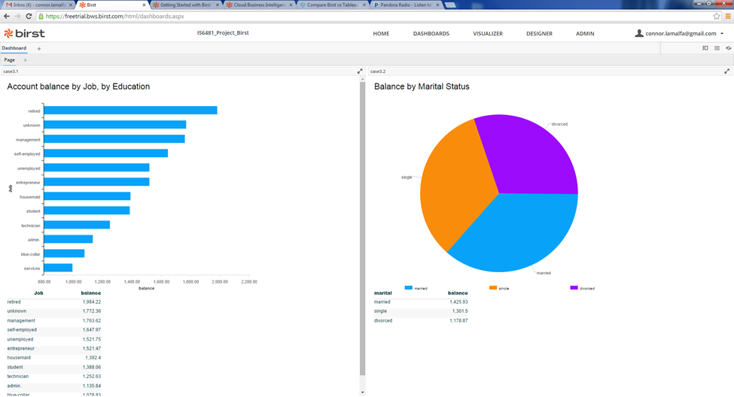
Birst Visuals

Slide 10
Positives
Negatives
The design and overall aesthetic appeal is simple, yet functional
Feels like a true enterprise software platform
Can handle large data volumes efficiently
Highly intuitive, with drag and drop fields for data visuals
Vast amount of support information, KB articles on menu
Tableau has a strong market position with a large high profile consumer base and market share
Customer surveys identified ease of use for end users and developers, and functionality as their main reason for choosing Tableau
Very pricey compared to other vendors
Single license Personal Edition = $999
Single license Professional Edition = $1,999
-Public Edition is a free product (data limitation) , but the two editions above allow you to save your work to your own computer and share files locally.
Options for purchasing other support options, but no default chat support availability

Slide 11
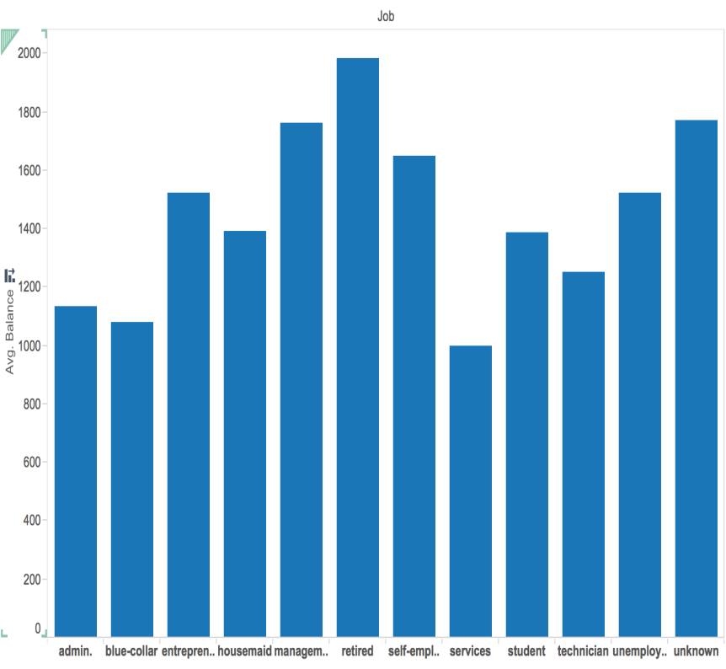
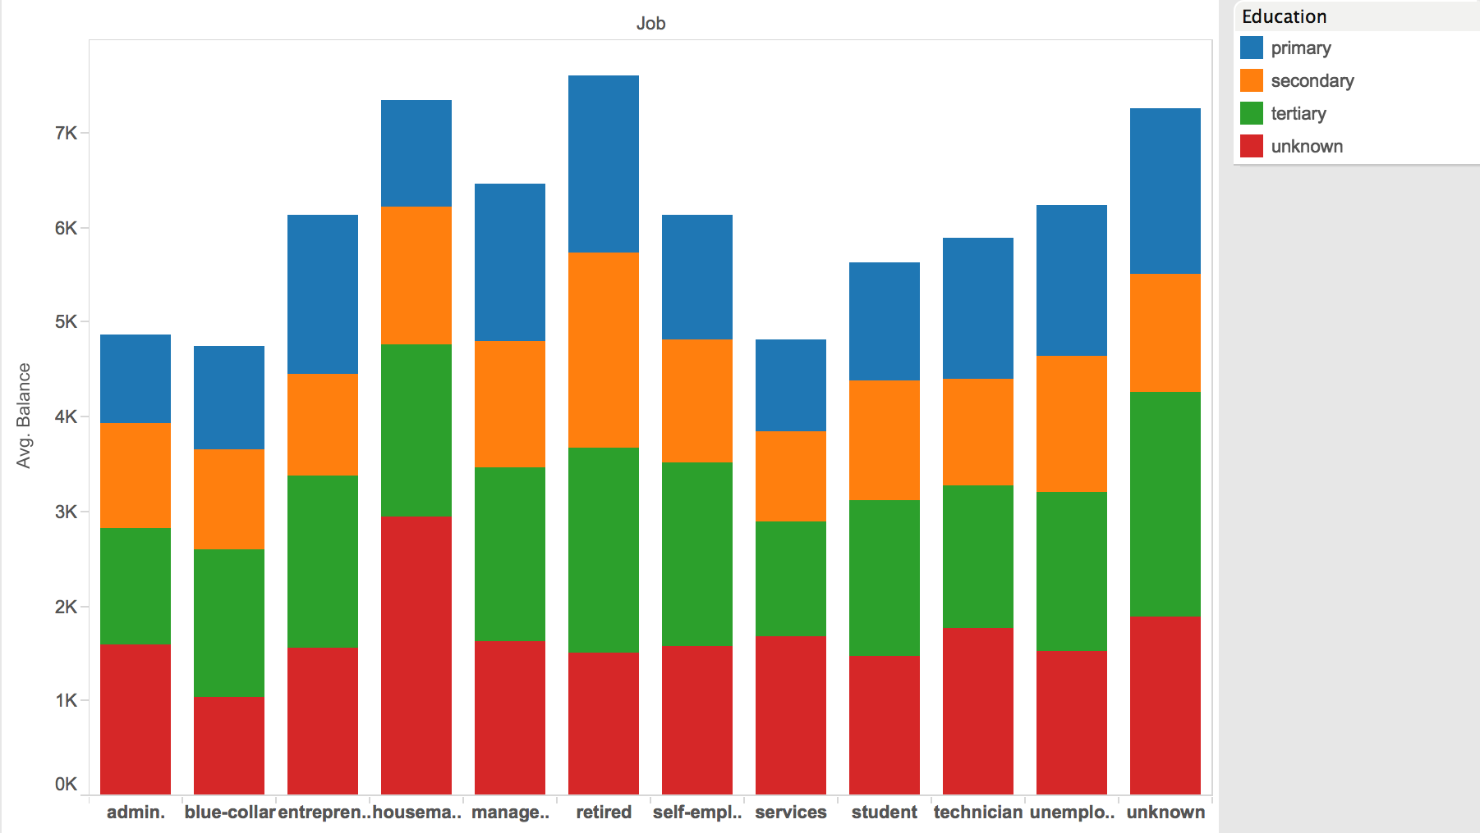
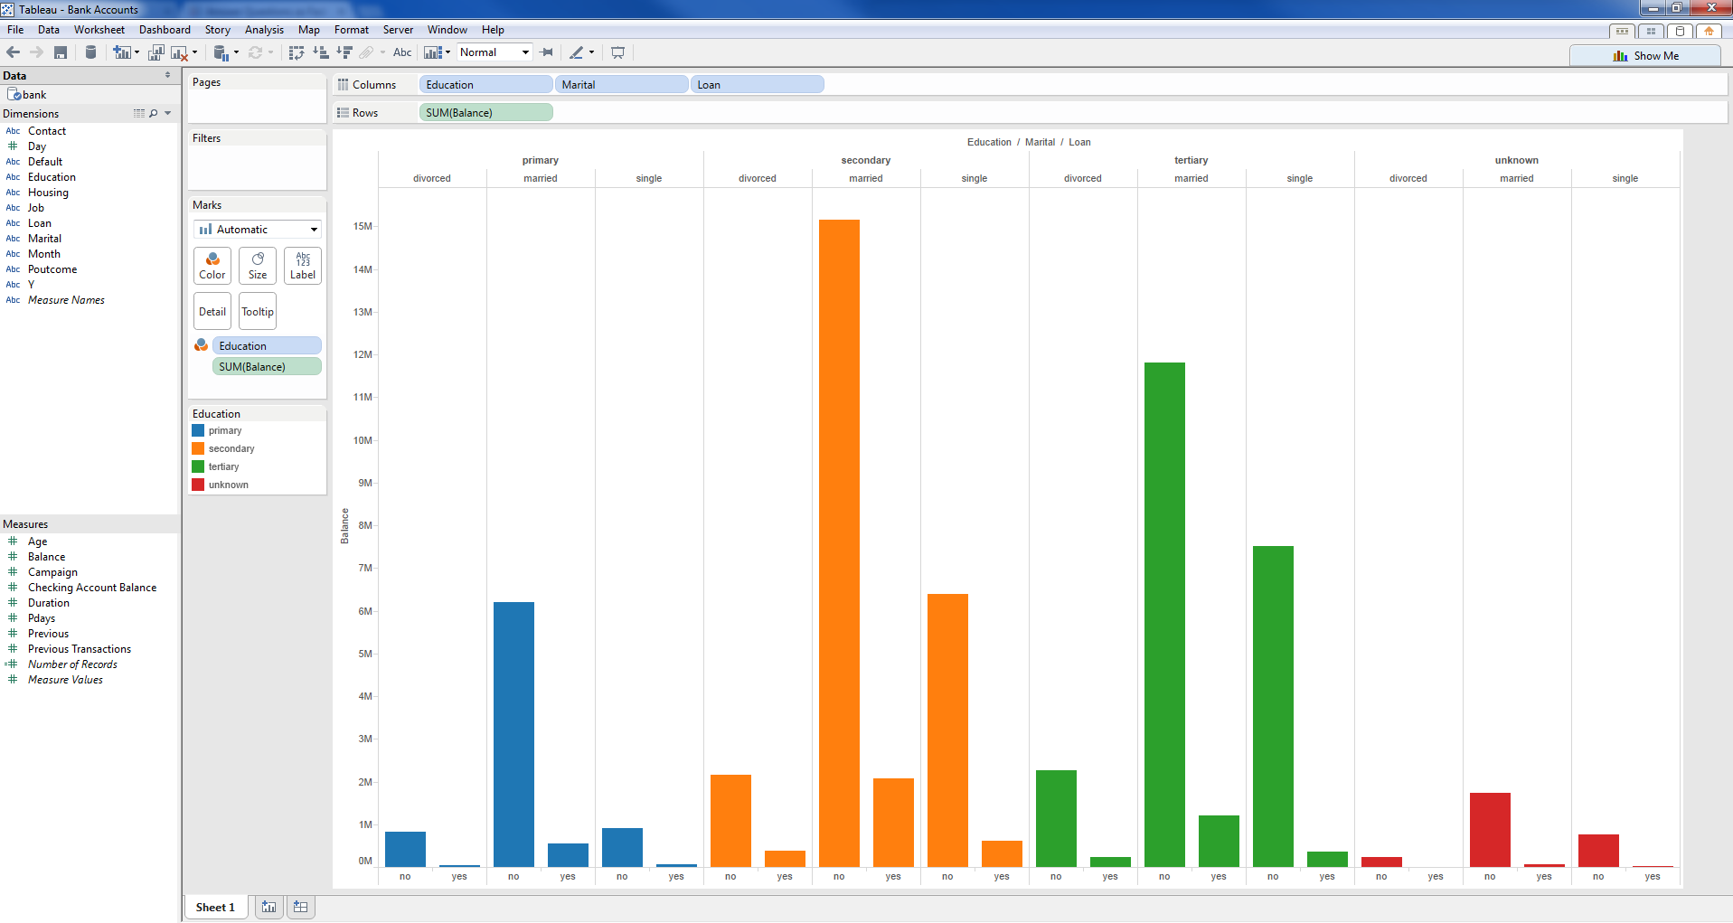
Tableau Visuals
Average Balance by Job by Education
Average Balance by Job
Balance by Education by Martial status by Loan

Slide 12
Pros
Cons

Slide 13
Recommendations
Qlik Score 887.5
Birst Score 757.5
MasterControl product managers who will be actively working with this tool will find it easy to work with, as well as quick access to visualizations. After only a short amount of time I was able to navigate the menus, load data and begin creating visualizations for insights
Master Control current data warehouse software can fully integrate with Qlik, as both utilize SSIS and Microsoft SQL
The ease of use and functionality of this BI tool addresses the pain point which MasterControl and its non-executive users were experiencing with their prior BI visualization utility.
Proven Professional’s would recommend Qlik to MasterControl
Birst has made large market gains in recent years due to its elevated ability to pull data sources from cloud-hosted environments, and others which MasterControl require for analysis
Although Birst was easy to navigate and load data, the visualization tool was extremely difficult to use for graph, chart and data table creation, customization and editing.
Do not think Birst would be a good fit for MasterControl due to the requisite level of expertise a user would need to have (relatively low level users).
Issue is amplified as a result of the lack of quality support resources and documentation that seems to be available at this time
Cost-wise this product is well priced in comparison
Proven Professional’s are split on recommending Birst to MasterControl

Slide 14
Recommendations
Logi Analytics
Tableau
Recommend this product based on general functionality and cost-effectiveness relative to other software
There are some reservations about the usability as there are few options for customizing visuals, which MasterControl needs
Proven Professional’s are undecided on recommending Logi Analytics to MasterControl
Tableau is very easy-to-use, well-designed product, which would required limited aid from IT in order to utilize effectively
Performs adequately with various sources of data, customizable visuals and support resources, which is desired by MasterControl
Easily integrated into current data warehouse environment with great performance on large volumes of data
The downside of Tableau is the price, which is substantially higher depending on the amount of licenses required.
Proven Professional’s would recommend this product to MasterControl if cost is not a major deciding factor or concern

